Slide 1
From Economics, With Love: Causes and Counterfactuals in the Age of Machine Learning
Rocco Hu (I504371), SAP
Month 03, 2020

Slide 2
Contents
A Primer on Causes and Counterfactuals
Causal Inference in Cross-Sectional Data: Toy Example
Causal Inference in Time-Series Data: Effect of Marketing Campaign on Sales
Concluding Remarks

Slide 3
1. A Primer on Causes and Counterfactuals

Slide 4




1. A Primer on Causes and Counterfactuals
Causation
Query | What if X hadn’t occurred?
Example | What if I hadn’t gone to the hospital? What if I spent even more on advertising?
Correlation
Query | I see X. What comes next?
Example | What kind of symptoms are common for this disease?

Slide 5

Correlation vs Causation: Some Teasers
Lots of people die in hospitals
Should I avoid going to them?
I got more sales in December when I spent more on advertising
Does it mean I advertise even more?

Slide 6
Causes and Counterfactuals
Regularity Theory
“X causes Y” means just we see Y after we see X. (Hume, 1739)
Problem: Roosters crow before sunrise.
Counterfactual Theory
Later, Hume claimed that “X causes Y” means if X had not existed, Y wouldn’t too
Problems?

Slide 7
2. Causal Inference in Cross-Sectional Data

Slide 8
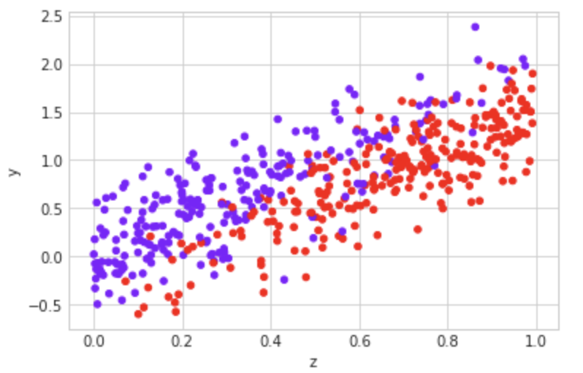
2. Causal Inference in Cross-Sectional Data
Survival Index
Y: Survival index
Z: Pre-existing health conditions
Purples: In-hospital populations
Reds: Out-of-hospital populations
Reds on average do better on the survival index
Pre-existing health

Slide 9
2. Causal Inference in Cross-Sectional Data
Survival(went to hospital) – Survival(stayed home)
=
Observed Difference
Survival(went to hospital) - Survival(if they had stayed home)
Treatment Effect
+
+Survival(if they had stayed home) - Survival(stayed home)
Selection Effect

Slide 10
3. Causal Inference in Time-Series Data: Effect of Marketing Campaign on Sales

Slide 11
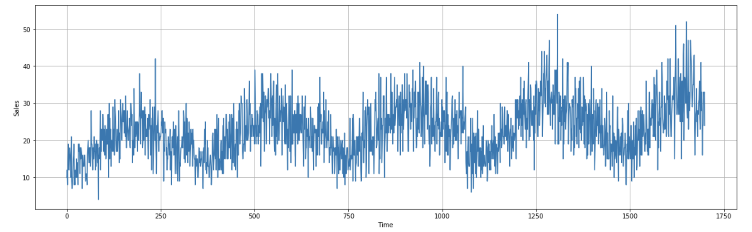
Forecasting Shop Sales
Problem
A business wants to measure the effect of a marketing campaign on sales
Data
1700 observations taken from the Kaggle’s daily sales dataset
Slight trend with seasonality and noise
At Time = 1400, I simulate the running of a marketing campaign (the intervention).

Slide 12
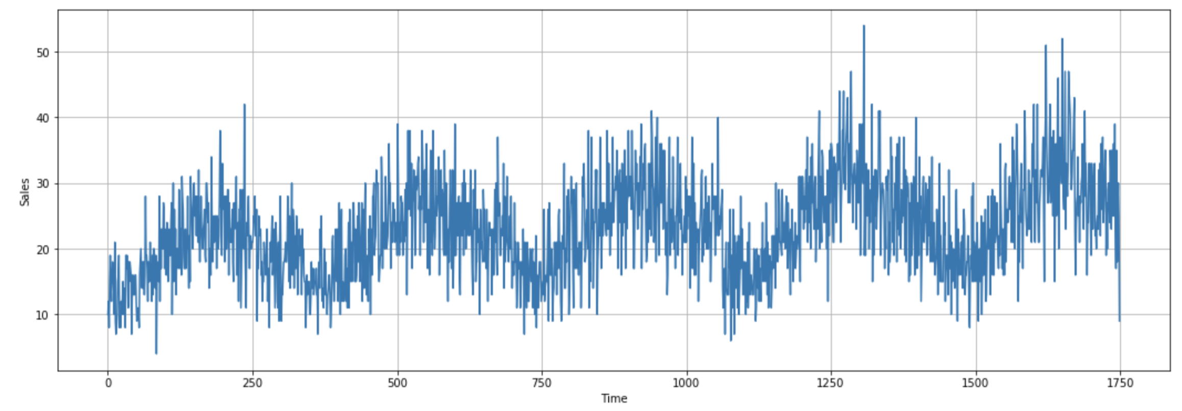
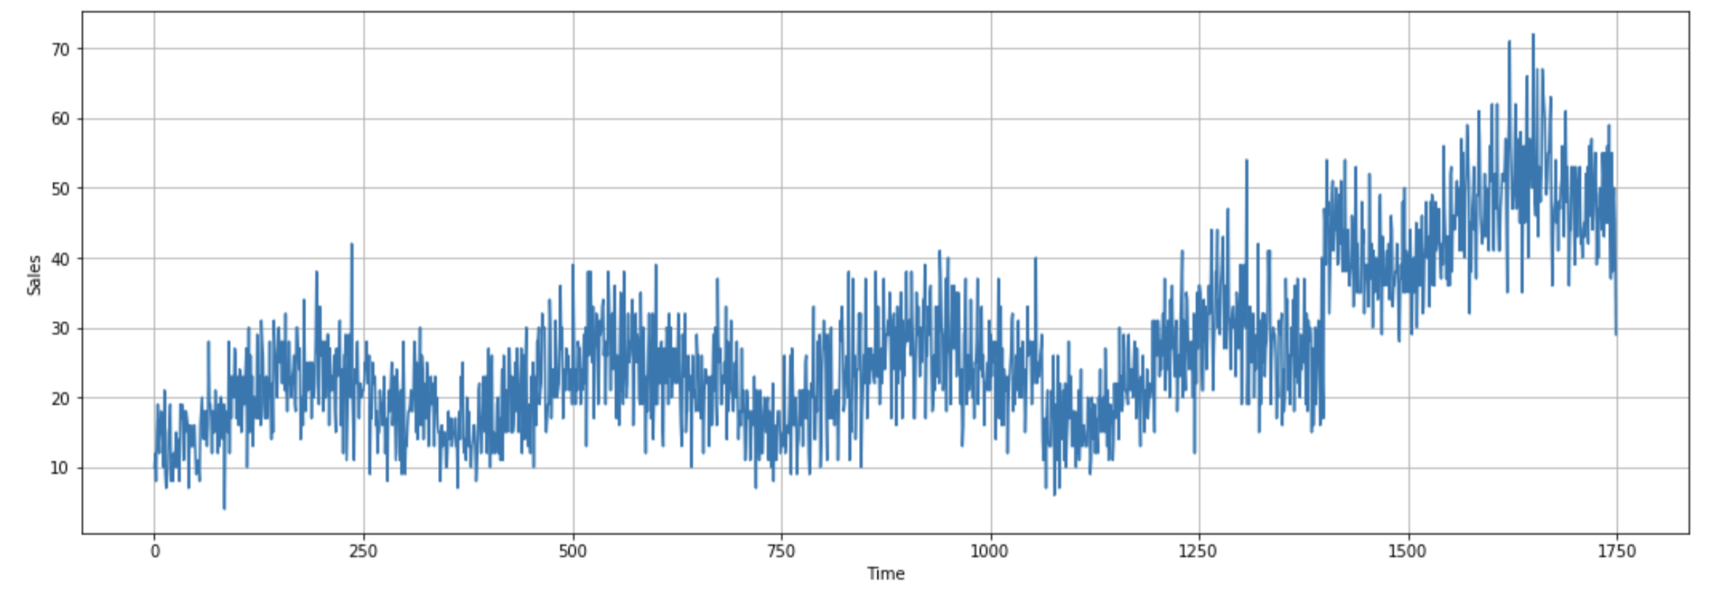
Forecasting Shop Sales
Original Dataset
After Marketing
Marketing Campaign at t=1400

Slide 13
Forecasting Shop Sales
So how much sales impact did my campaign actually have?
Post-intervention data
Marketing Campaign

Slide 14
Forecasting Shop Sales
STEP ONE
Train TS models and assess accuracy on validation period
MAE, MSE errors
Train
Validation
Sliding windows

Slide 15
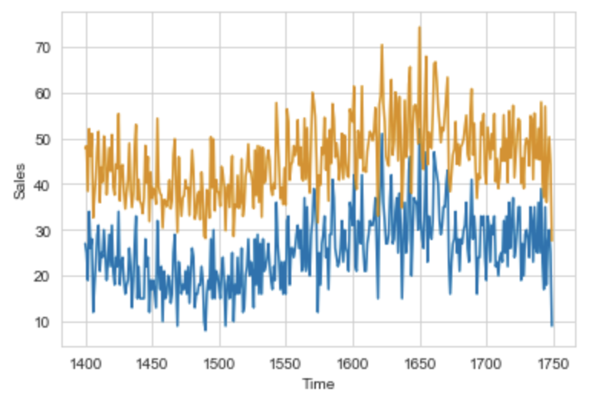
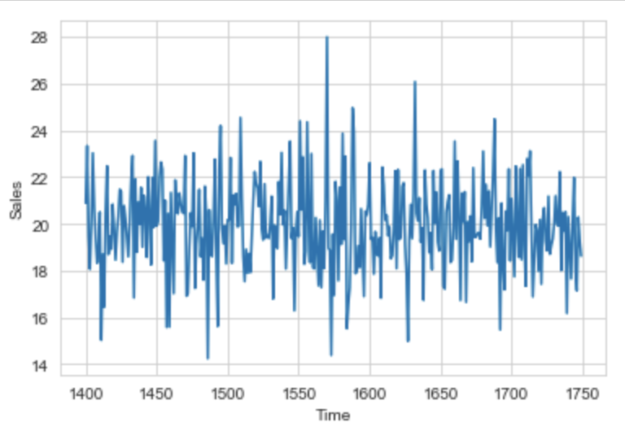
Use Case: Forecasting Shop Sales
STEP TWO
Calculate
true_causal_effect = Series[‘Post_Campaign’] – Series[‘Validation’]
est_causal_effect = Series[‘Post_Campaign’] – Model_Predictions
Then,
MAE(true_causal_effect, est_causal_effect)
==
MAE(-Series[‘Validation’], – Model_Predictions)
== Evaluation results from STEP ONE

Slide 16
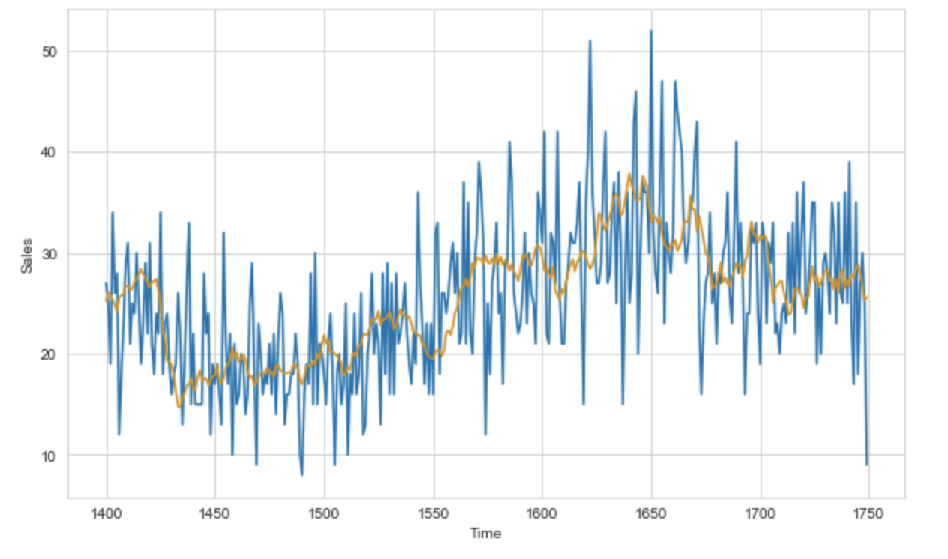
Baseline : Moving Average
Moving Average Forecast = 60-day moving average + 1 year differenced moving average
Results
Mean Absolute Error: 42.0
Mean Squared Error: 5.02

Slide 17
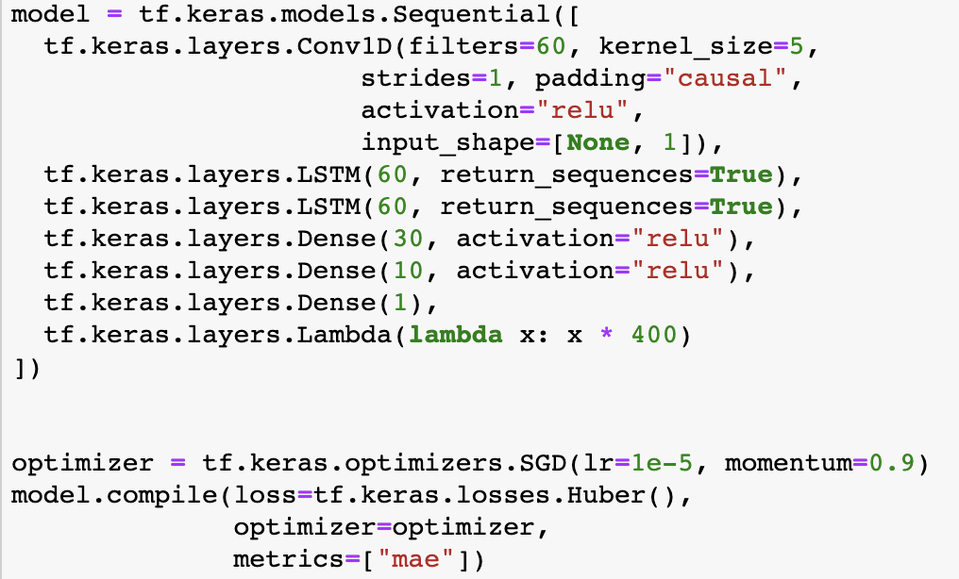
ConvLSTM Neural Network: Architecture
1 Base convolutional layer
2 LSTM layers
1 Lambda layer for optimisation
Huber loss function: less sensitivity to

Slide 18
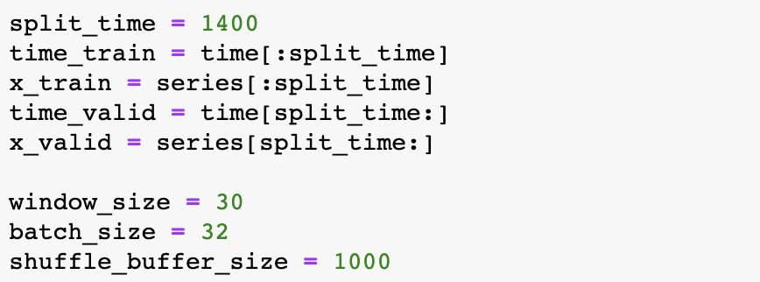
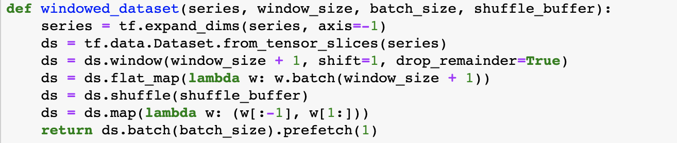
ConvLSTM Neural Network: Preprocessing
Split the dataset into train and validation sets
Make labelled datasets with the data

Slide 19
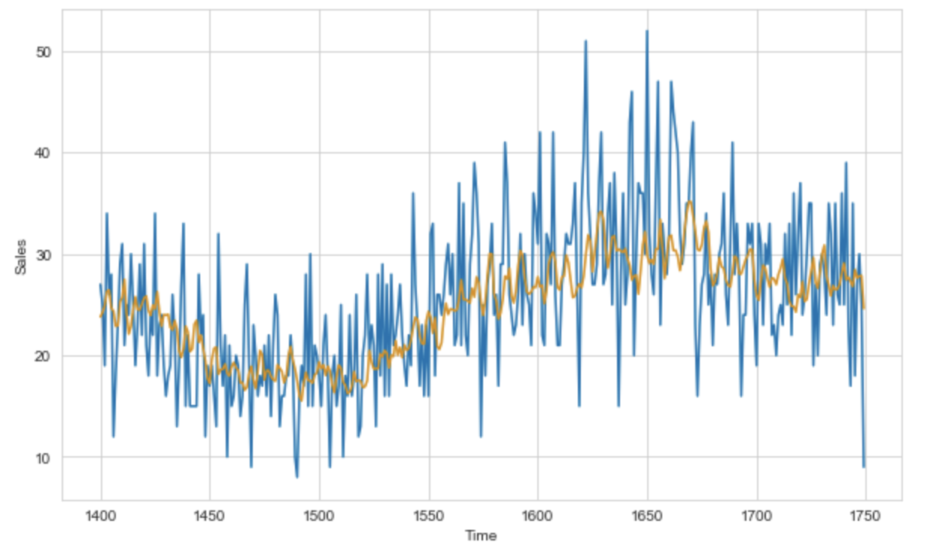
ConvLSTM Neural Network: Results
Mean Absolute Error: 39.95
Mean Squared Error: 4.95

Slide 20
4. Concluding Remarks

Slide 21
Concluding Remarks
Other Use-cases for this approach:
How did a change in Central Bank policy affect stock prices?
How did the introduction of a vaccine affect infection rates of a virus?
How did sales churn rates change after rolling out this new HANA product
How many more total clicks did our app get after we changed the UI?

Slide 22
Concluding Remarks
In this example, Deep NNS marginally better than naïve approach
Deep NNS potentially stronger in multivariate case due to better ability to exploit complex relationship between covariates
Relies on stationarity of the series being predicted
Visual Inspection, Differencing, Augmented Dickey-Fuller
Assumes the other relationships between the predictors and series being predicted is the same throughout the pre-and-post intervention periods.
To minimize this, collect as many covariates as possible and include them in the modelling

Slide 23
Concluding Remarks
Deep NNS cannot converge for smaller data sets
No confidence interval for predictions, unlike Bayesian estimation approaches (Google CausalImpact)
Forward-looking causal inferences?

Slide 24
References
Machine Learning and Econometrics, Hal Varian 2014 https://web.stanford.edu/class/ee380/Abstracts/140129-slides-Machine-Learning-and-Econometrics.pdf
Predict Future Sales, Kaggle https://www.kaggle.com/c/competitive-data-science-predict-future-sales/
RobustTrend: A Huber Loss with a Combined First and Second Order Difference Regularization for Time Series Trend Filtering https://arxiv.org/abs/1906.03751
CausalImpact, Google https://github.com/tcassou/causal_impact
Causal Inference with Python, Degenerate state http://www.degeneratestate.org/posts/2018/Mar/24/causal-inference-with-python-part-1-potential-outcomes/

Slide 25
Thank you.

